Slide 1


HEALTH HABIT TRACKER 2025-2026
PRESENT BY:
BLACK SQUAD

Slide 2
HACKNEXT-25
Team Members
Name. Karthikeyan.M
Name. Ajees A
Name. Akil A
I-B.TECH,INFORMATION TECHNOLOGY
SNS College of Technology
Developer
I-B.TECH,INFORMATION TECHNOLOGY
SNS College of Technology
Developer
I-B.TECH,INFORMATION TECHNOLOGY
SNS College of Technology
Developer
Student Team

Slide 3
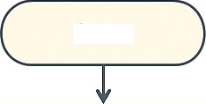
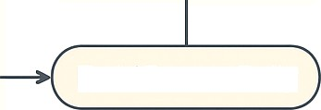
HEALTH HABIT TRACKER
Start
User Sign-In / Sign-Up Email, Google, or Social Login
User Profile Setup Name, Age, Weight, Height, Goals
Select Habits to Track Food Intake Water Consumption Sleep Hours Exercise / Activity ° Mental Health Check (Optional)
Daily Logging Add food, water sleep, execise logs Mood / Mental Health Input
Analytics & Insights Daily summary Weekly trends Visual charts: Ple, Bar Line Health score or recommendations
AI Suggestions / Smart Tips (Optional) Diet recommendations ° Sleep improvement tips Activity suggestions bases
Future Enhancement Loop
User feedback
New habit options
Integration with wearable devices
Future Enhancement Loop
User feedback
New habit options
° Integration with
wearable devices
End / Repeat Daily

Slide 4

HEALTH HABIT TRACKER
PROBLEM STATEMENT
•People struggle to maintain
consistency in tracking their health habits such as food intake, water consumption, sleep, and overall wellness.
•Manual tracking methods are time- consuming and often lead to
inaccurate health insights.So,we
using like doctor bot

Slide 5
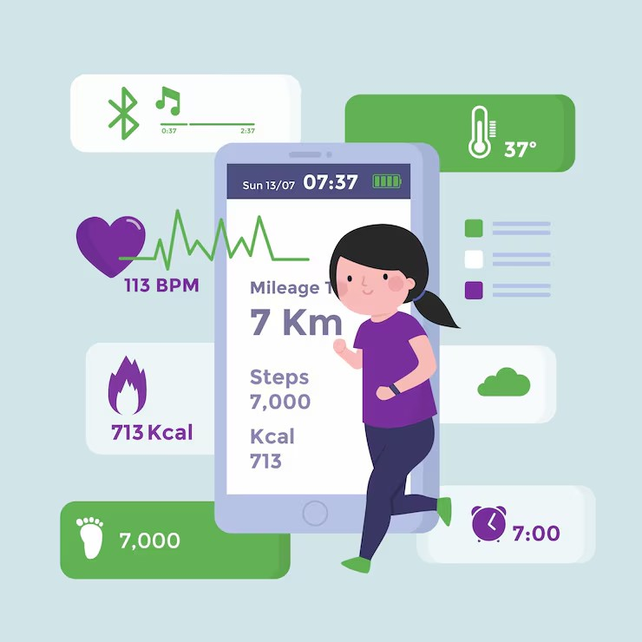
OBJECTIVES
OBJECTIVES OF HEALTH HABIT TRACKER
•To build a user-friendly website that helps users:
Log daily food, water, and sleep data
Monitor their weekly health progress
Gain insights through data visualization
Reflect on mental well-being

Slide 6
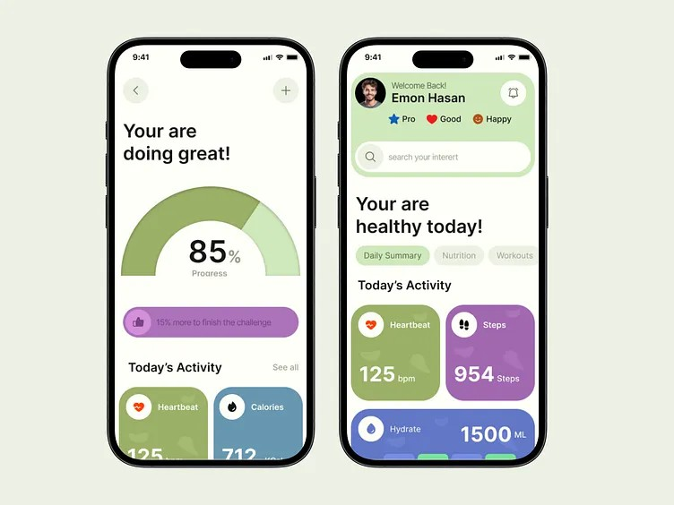
KEY FEATURES
Smart Health Tools
•User authentication
•Food, Water, and Sleep Logging
•Weekly Health Insights Dashboard
•Doctor chatbot AI
•Responsive C Minimal UI Design
•AI habit design
•Visual analytics

Slide 7
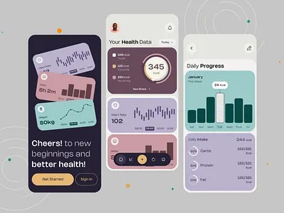
UI/UX DESIGN
User-Friendly by Design
Simple and intuitive layout
Figma-style color palette with modern gradients
Icon-based navigation for quick logging
Dashboard with cards for each health metric
Mobile-friendly responsive design

Slide 8
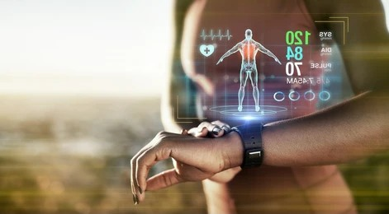
FUTURE ENHANCEMENTS
Upcoming Innovations
•Integration with wearable devices
•AI-based personalized health recommendations
•Community support for motivation
•Advanced data analytics and insights

Slide 9

CONCLUSION
*•The Health Habit Tracker promotes a balanced lifestyle by combining physical and mental health insights.
•
•It empowers users to stay consistent, track progress, and improve overall well-being.

Slide 10
The End
Thank You

